Slide 1
Adding Updating or Removing Portfolio Information in Bulk Using an Excel File and the Alma Portfolio Loader
Yoel Kortick
Senior Librarian

Slide 2

Introduction
Format of Excel sheet to upload
Uploading the Excel sheet
Uploading the Excel sheet – Complete – Add local
Uploading the Excel sheet – Complete – Delete
Uploading the Excel sheet – Incremental – Delete
Agenda

Slide 3
Introduction

Slide 4
Introduction
The recommended method of managing electronic portfolios is to have the portfolios as part of an electronic collection and not as "standalone" portfolios.
In addition to having an organized collection of portfolios, another benefit includes the ability to easily make global changes on several portfolios.
This presentation will show how multiple portfolios may be uploaded and edited in batch mode via an Excel file.

Slide 5
Introduction
It is possible to load multiple portfolios to an electronic collection via an Excel sheet of portfolios
The Excel sheet is typically:
Received from a vendor, or
Created by library by exporting the content of the electronic collections and then making changes to the Excel
  The changes reflect the changes that should be done to the content of the electronic collection

Slide 6
Introduction
The File Upload wizard allows the staff user to load portfolios in one of the following two manners:
A complete set of portfolios
  This is "type = complete"
Only the portfolios that have been updated since the last load
  This is "type = incremental"

Slide 7
Introduction
For type "Complete" the options are
  Add local portfolios
  Update portfolios
  Delete portfolios
For type "Incremental" the options are
  Add new
  Delete
  Update

Slide 8
Introduction
This presentation will explain all options and then show real examples for:
Type "Complete" with option "Add local portfolios"
Type "Complete" with option "Delete portfolios"
Type "Incremental" with option "Delete"
It is recommended to also see Bulk Imported Portfolios

Slide 9
Format of Excel sheet to upload

Slide 10
Format of Excel sheet to upload
To see the format of the Excel sheet to upload it is easiest to export a file of existing portfolios in an electronic collection
The portfolios will be exported to the format which Alma expects to receive when uploading
This is a proprietary format of Ex Libris

Slide 11
Format of Excel sheet to upload
To export the Excel sheet of existing portfolios in an electronic collection:
Search for electronic collection
Click "Edit Service"
Switch to 'Portfolios' tab
Click "Export list > Extended Export"
Note that instead of steps 2 and 3 above the staff user can instead click "Edit full text portfolios". This will bring the staff user directly to the 'Portfolios' tab of the service

Slide 12
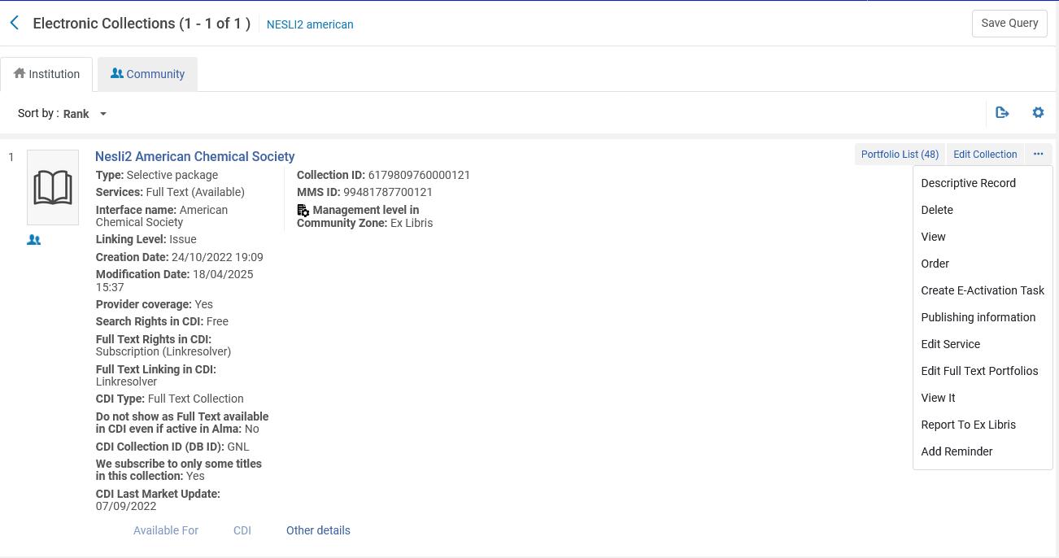
Format of Excel sheet to upload

Slide 13
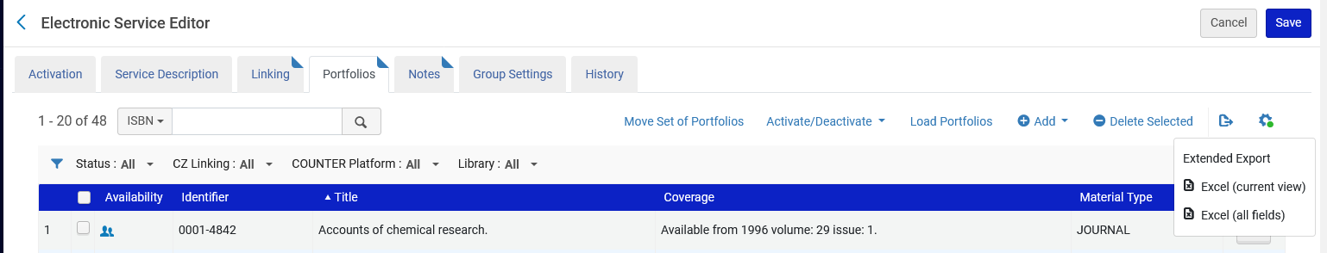
Format of Excel sheet to upload

Slide 14
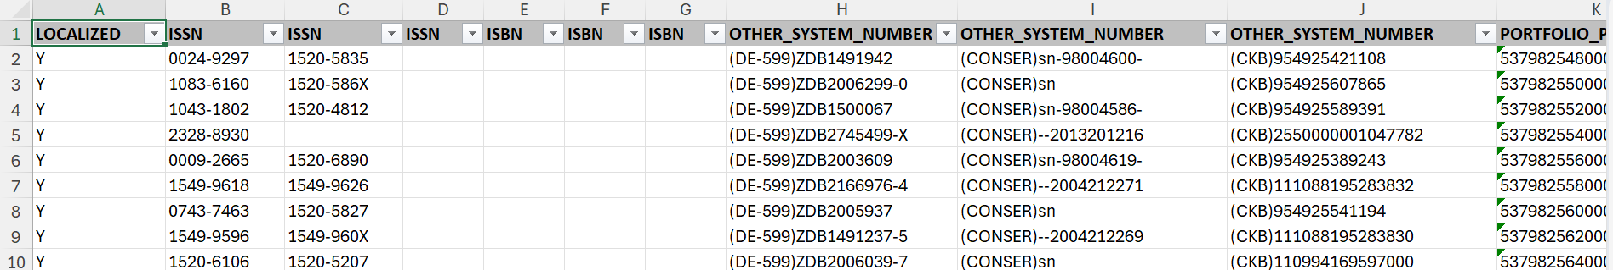
Format of Excel sheet to upload
The file will be created in Excel in the exact format needed by Alma.
Below is part of the file

Slide 15
Uploading the Excel sheet

Slide 16
Uploading the Excel sheet
To upload the Excel sheet of portfolios:
Search for electronic collection
Click "Edit Service"
Switch to 'Portfolios' tab
Click "Load Portfolios"
Note that instead of steps 2 and 3 above the staff user can instead click "Edit full text portfolios". This will bring the staff user directly to the 'Portfolios' tab of the service

Slide 17

Uploading the Excel sheet

Slide 18
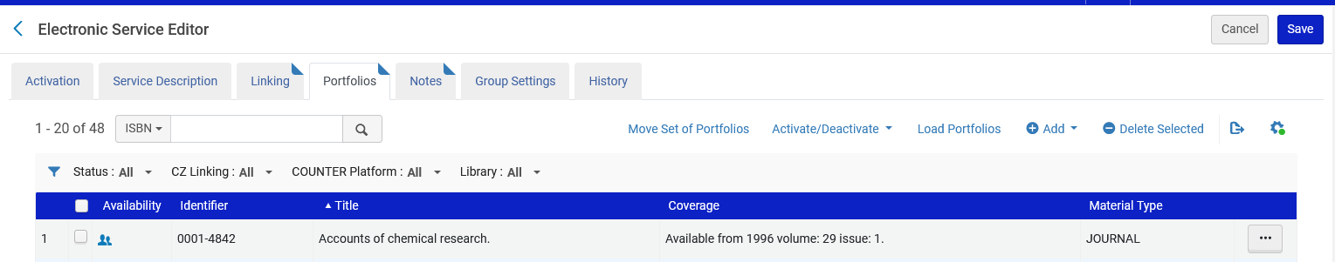
Uploading the Excel sheet

Slide 19
Uploading the Excel sheet
After clicking "Load Portfolios" the user may choose between "Complete" and "Incremental". Both types will be explained more clearly in a moment with a real live example
Complete – Loads a complete set of portfolios, in the loaded file overwriting any existing portfolios.
Incremental – Loads a file that includes only the incremental changes to the portfolio list of a specific electronic collection. With this option the staff user can load only the portfolios that have been updated since the last load.

Slide 20
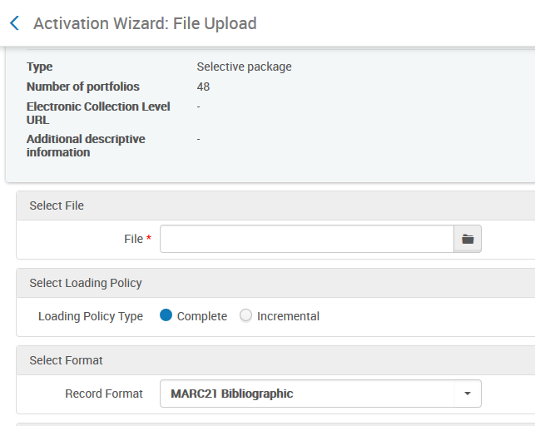
Uploading the Excel sheet

Slide 21
Uploading the Excel sheet – Complete – Add local

Slide 22
Uploading the Excel sheet – Complete – Add local
When choosing "Complete":
Add local portfolios.
  If a match is found in the CZ, then it will become linked to a CZ portfolio.
  If a match is not found in the CZ, then it will become to a local portfolio
Update portfolios
  For portfolios linked to the CZ only the "override" information in the portfolio will be updated
Delete portfolios
  If a portfolio is part of the electronic collection and not in the Excel input file, then it will be deleted.
  What is both in the Excel input file and in the collection will not be deleted

Slide 23
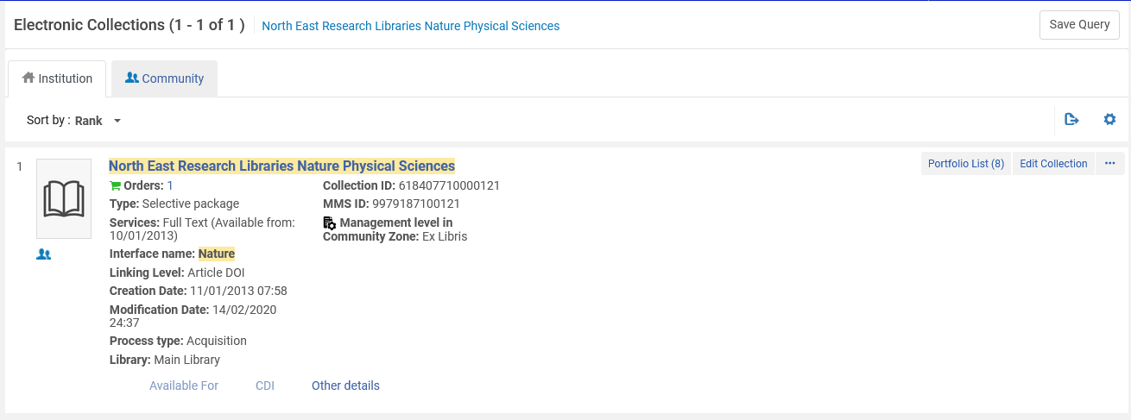
Uploading the Excel sheet – Complete – Add local
In order to "test" the "Add Local Portfolios" we will use electronic collection "North East Research Libraries Nature Physical Sciences"
It has eight portfolios from the CZ.
None of the eight portfolios is "Nature Chemical Biology"

Slide 24
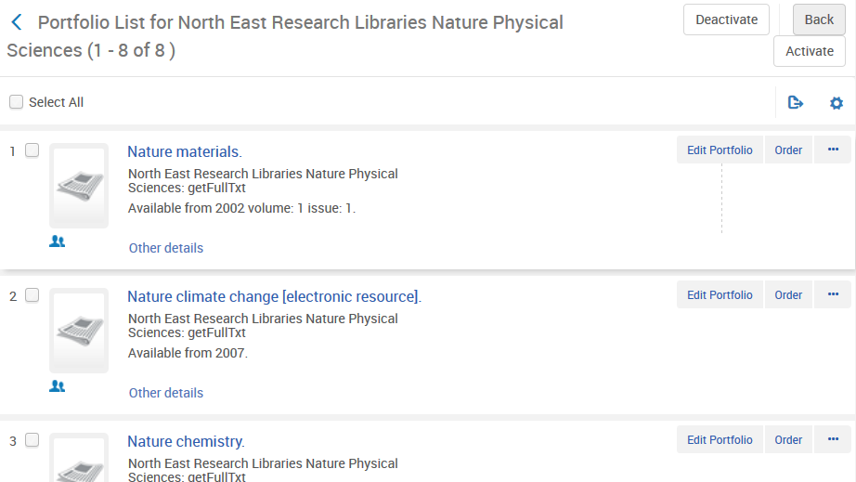
Uploading the Excel sheet – Complete – Add local
Existing portfolios for "North East Research Libraries Nature Physical Sciences" do not include "Nature Chemical Biology"

Slide 25
Uploading the Excel sheet – Complete – Add local
We have an input file with "Nature chemical biology" ISSN 1552-4450 (screenshots showing part of one row of the Excel file)

Slide 26
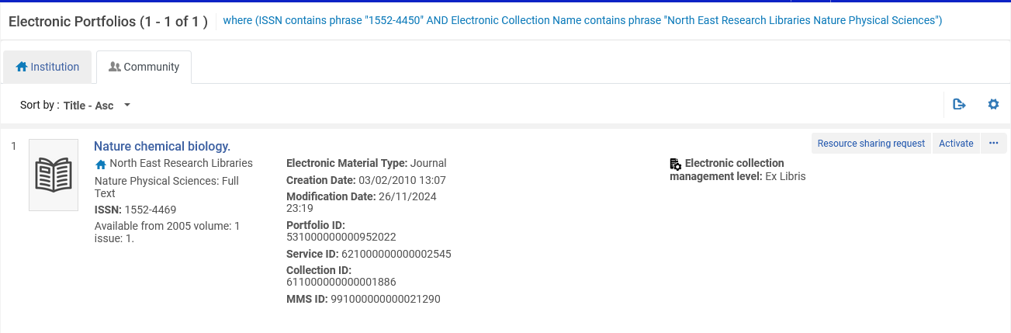
Uploading the Excel sheet – Complete – Add local
ISSN 1552-4450 exists in the CZ for electronic collection "North East Research Libraries Nature Physical Sciences"

Slide 27
Uploading the Excel sheet – Complete – Add local
Because "Nature chemical biology" ISSN 1552-4450 exists in CZ then when it is uploaded it should be matched with the record in the CZ and become a CZ (global) portfolio.
If it did not exist in the CZ then it would become a local portfolio.

Slide 28
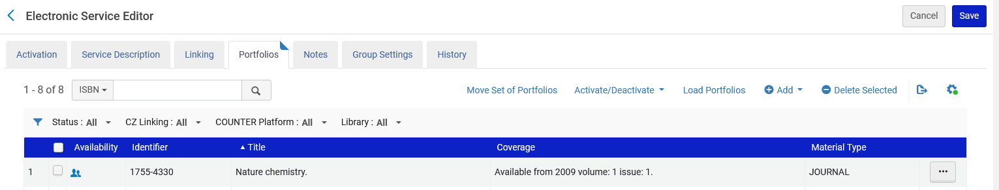
Uploading the Excel sheet – Complete – Add local
From the portfolios tab of the electronic service the file is uploaded.

Slide 29
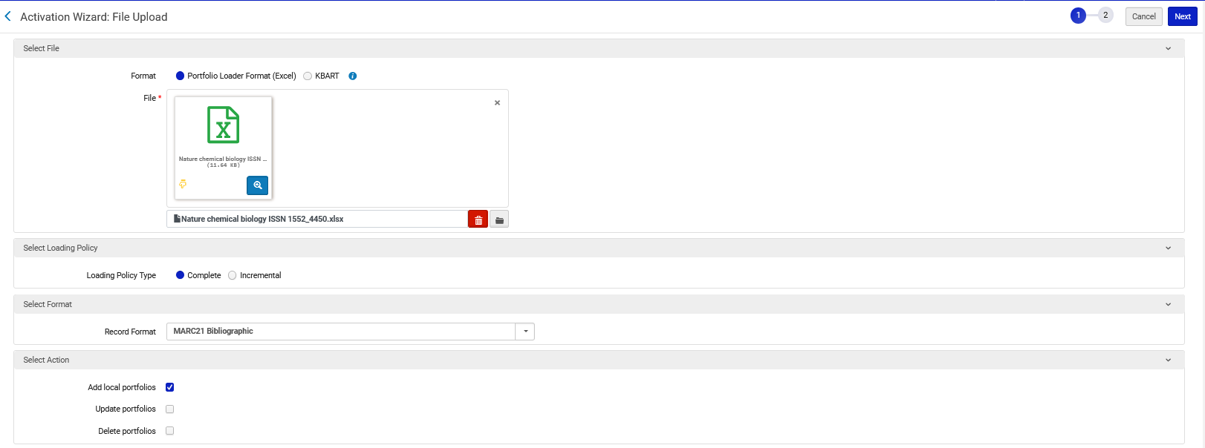
Uploading the Excel sheet – Complete – Add local
"Complete" and "Add local portfolios" is chosen

Slide 30
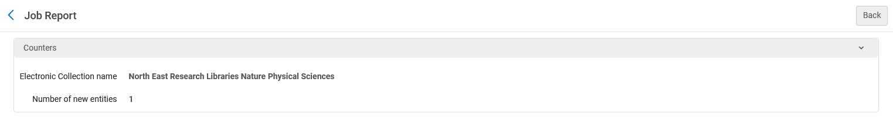
Uploading the Excel sheet – Complete – Add local
The job report shows us that one new entity was added

Slide 31
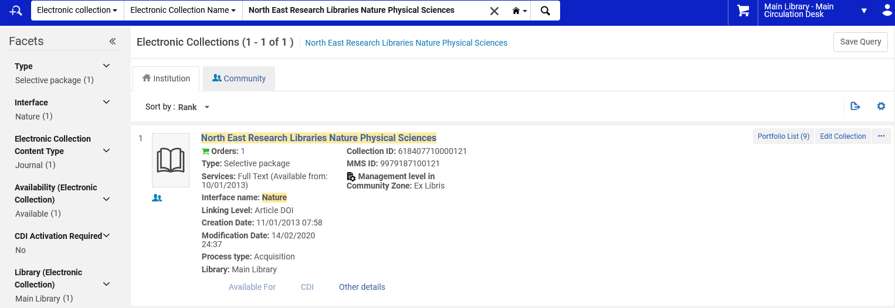
Uploading the Excel sheet – Complete – Add local
Now there are nine portfolios in "North East Research Libraries Nature Physical Sciences" in the institution

Slide 32
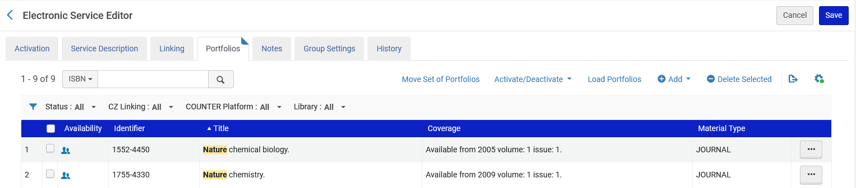
Uploading the Excel sheet – Complete – Add local
The portfolio was added to "North East Research Libraries Nature Physical Sciences" and a match was found in the CZ so now it is a CZ portfolio

Slide 33
Uploading the Excel sheet – Complete – Delete

Slide 34
Uploading the Excel sheet – Complete – Delete
Now we will do another test.
This time we will use
  "Loading Policy Type" = "Complete"
  "Action" = "Delete"

Slide 35
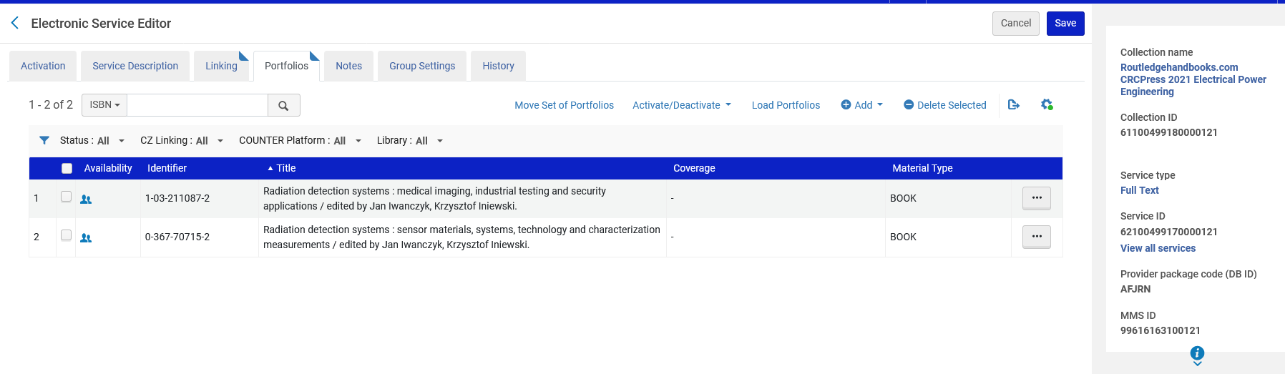
Uploading the Excel sheet – Complete – Delete
Collection "Routledgehandbooks.com CRCPress 2021 Electrical Power Engineering" has two CZ portfolios:
  Radiation detection systems : medical imaging … (ISBN 1-03-211087-2)
  Radiation detection systems : sensor materials … (ISBN 0-367-70715-2)

Slide 36
Uploading the Excel sheet – Complete – Delete
The input file has only the CZ portfolio "Radiation detection systems : medical imaging …" (screenshots showing part of one row of the Excel file)

Slide 37
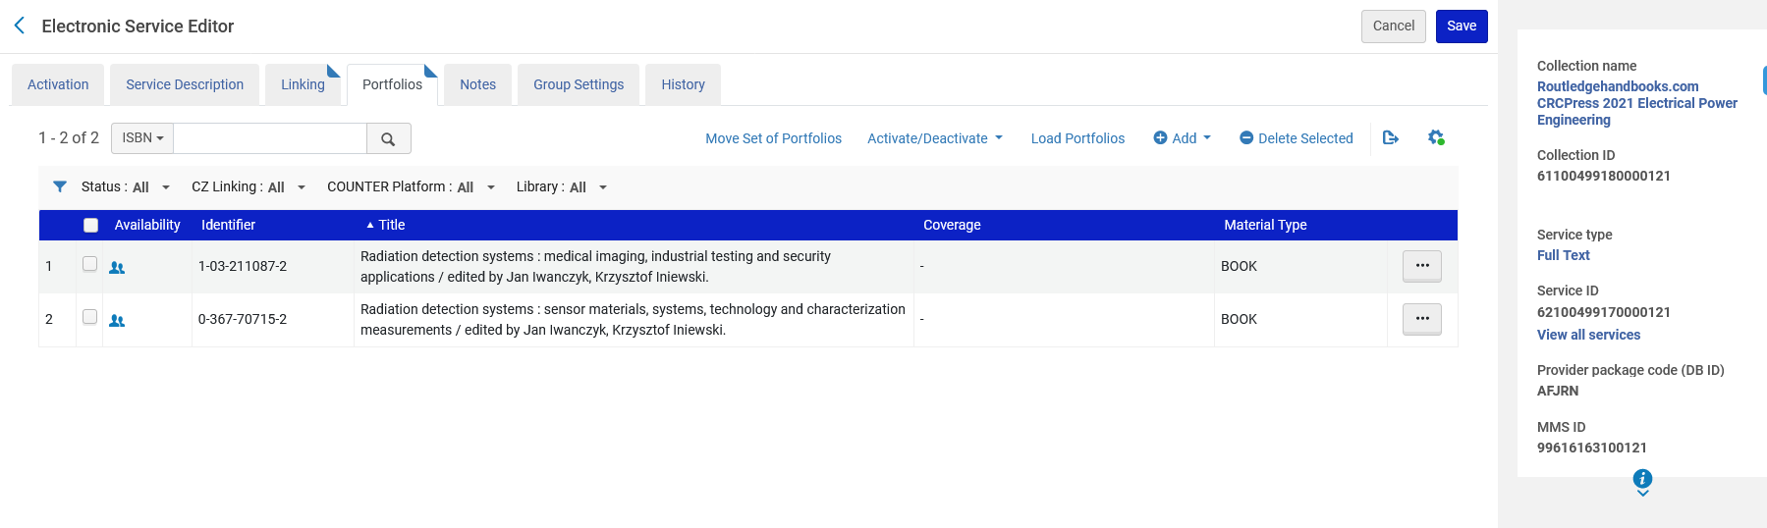
Uploading the Excel sheet – Complete – Delete
We upload the file

Slide 38
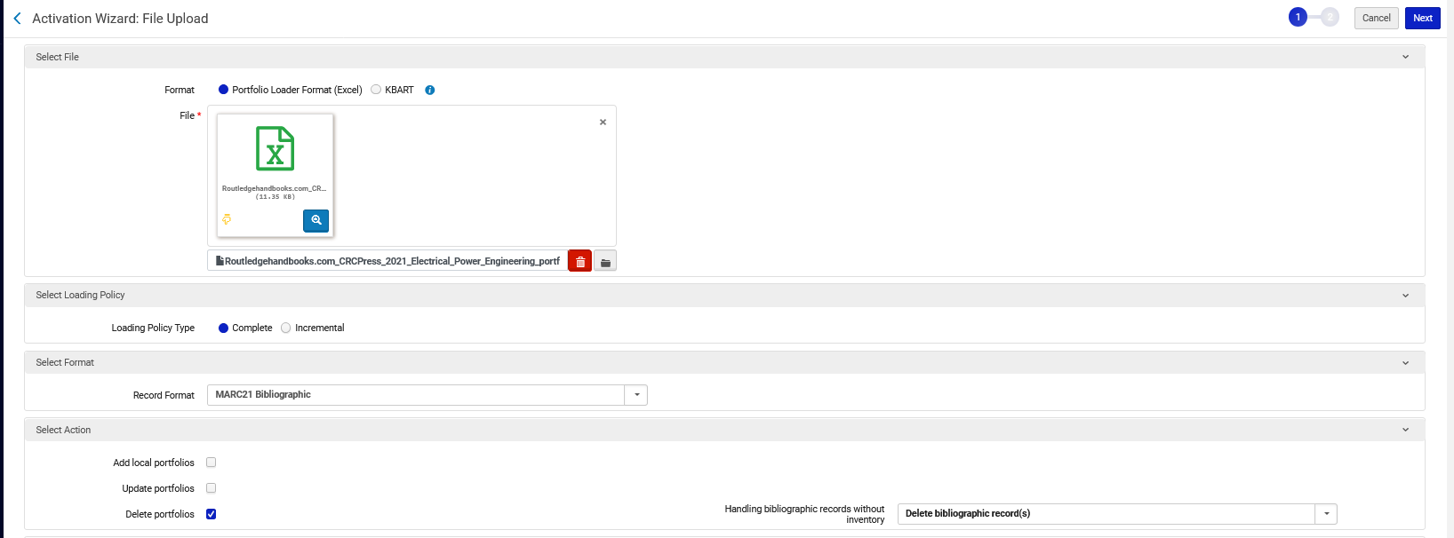
Uploading the Excel sheet – Complete – Delete
We upload the file with Loading Policy Type "Complete" and Action "Delete"
When Loading Policy Type is "Complete" and the Action is "Delete" then portfolios are deleted from the electronic collection if they do not exist in the input file. Therefore:
Radiation detection systems : medical imaging … (ISBN 1-03-211087-2) should not get deleted because it is in the input file.
Radiation detection systems : sensor materials … (ISBN 0-367-70715-2) should get deleted because it is not in the input file

Slide 39
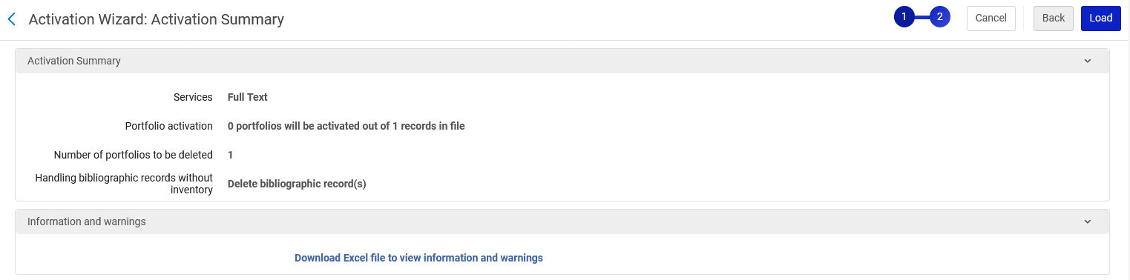
Uploading the Excel sheet – Complete – Delete
We are told that one portfolio will be deleted

Slide 40

Uploading the Excel sheet – Complete – Delete
One portfolio was deleted.
The portfolio that remains is the portfolio that was in the input file: Radiation detection systems : medical imaging … (ISBN 1-03-211087-2)

Slide 41
Uploading the Excel sheet – Incremental – Delete

Slide 42
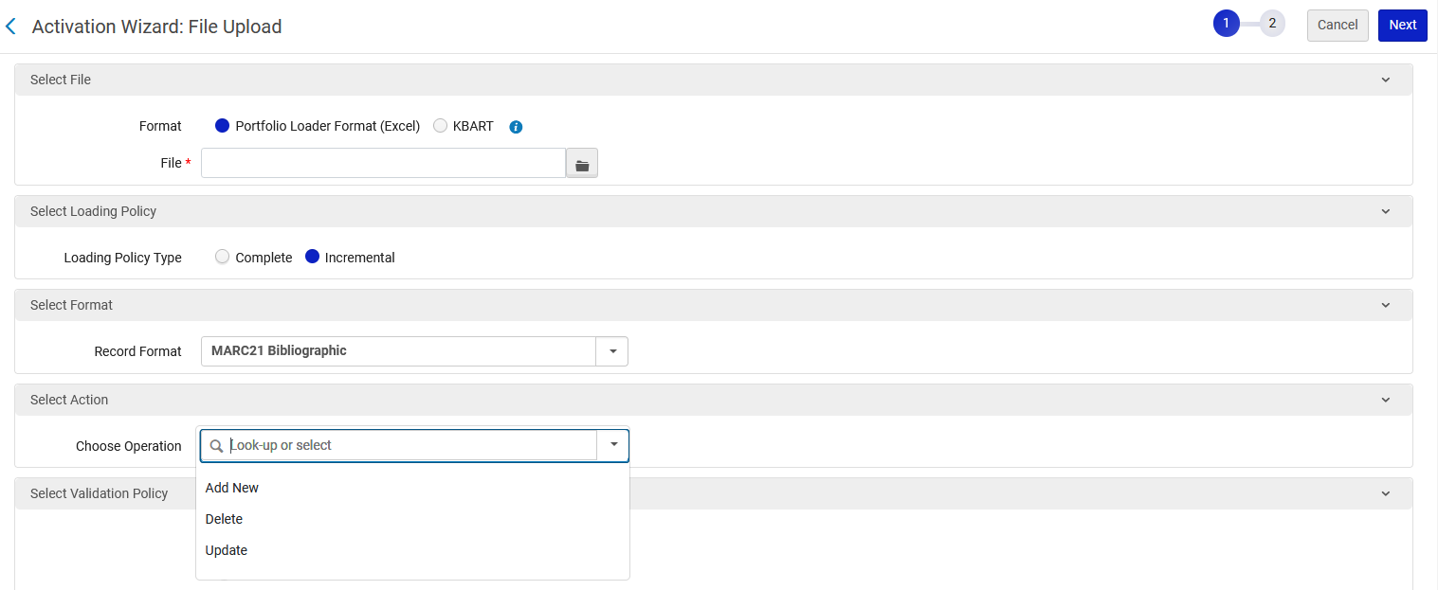
Uploading the Excel sheet – Incremental – Delete
When uploading the Excel file with Loading Policy Type "Incremental" there are three options:

Slide 43
Uploading the Excel sheet – Incremental – Delete
When uploading the Excel file with type "Incremental" there are three options:
Add New – Add portfolios that are in the input file as new portfolios to the electronic collection.
Update – Updates the details of all electronic collection portfolios that are in the file.
Delete – Deletes all electronic collection portfolios that are in the file. (This is the opposite of the Delete option under the "Complete" Loading Policy Type. In the "complete" loading policy type portfolios are deleted from the electronic collection if they do not exist in the input file)

Slide 44
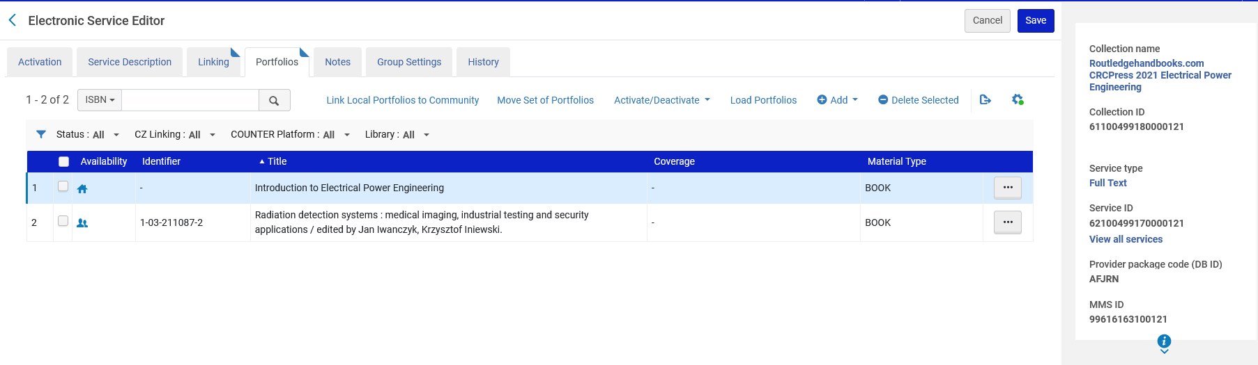
Uploading the Excel sheet – Incremental – Delete
Now we will choose to upload the Excel sheet with incremental option
Our example is Electronic Collection "Routledgehandbooks.com CRCPress 2021 Electrical Power Engineering" which has one global portfolio and one local portfolio
Local

Slide 45
Uploading the Excel sheet – Incremental – Delete
Our input file contains only the local portfolio (screenshots showing part of one row of the Excel file)

Slide 46
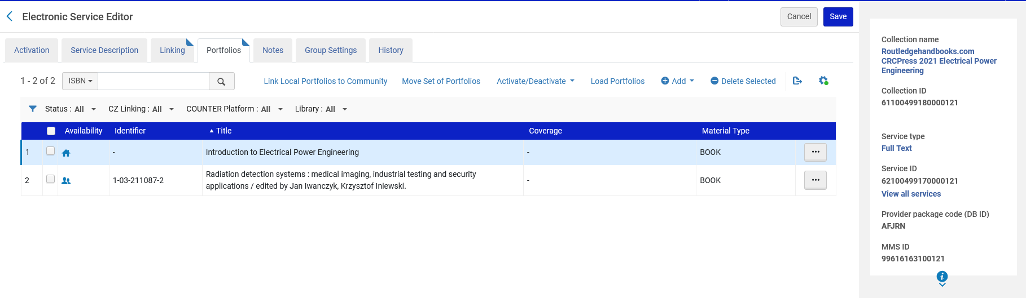
Uploading the Excel sheet – Incremental – Delete
We upload the file

Slide 47
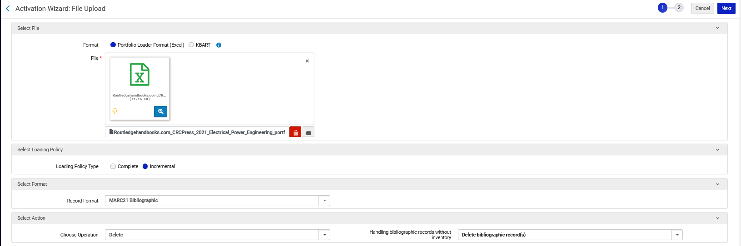
Uploading the Excel sheet – Incremental – Delete
We upload the file and choose Loading Policy "Incremental", and Action "Delete"

Slide 48
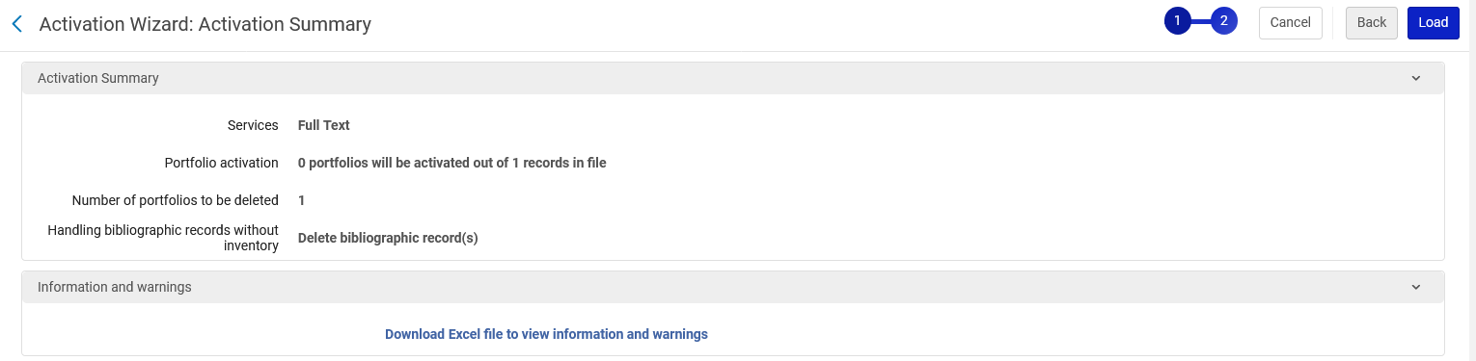
Uploading the Excel sheet – Incremental – Delete
We are told that one portfolio will be deleted

Slide 49
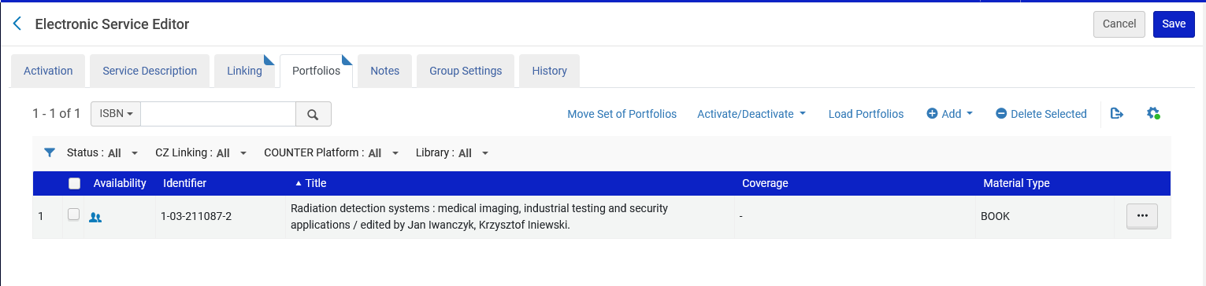
Uploading the Excel sheet – Incremental – Delete
The "Local Portfolio" has been deleted.
This means that using Loading Policy Type "Incremental" with Action "Delete" deletes the portfolio in the input file. This is the opposite of the Delete option under the "Complete" loading policy type.

Slide 50
xxx@exlibrisgroup.com

